Slide 1
4.5 Black-Scholes-Merton Equation part (1)
報告者：顏妤芳

Slide 2
We derive the Black-Scholes-Merton partial differential equation for the price of an option on an asset modeled as a geometric Brownian motion.
Determine the initial capital required to perfectly hedge a short position in the option.

Slide 3
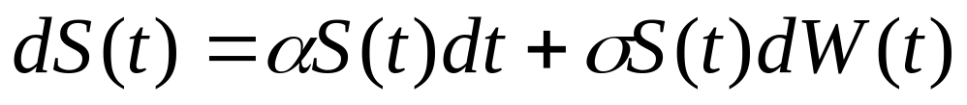


4.5.1 Evolution of Portfolio Value
Consider an agent who at each time t has a portfolio valued at X(t).
This portfolio invests in a money market account paying a constant rate of interest r and in a stock modeled by the geometric Brownian motion
(4.5.1)
The investor holds shares of stock. The position can be random but must be adapted to the filtration associated with the Brownian motion W(t),t 0.

Slide 4

MMA
=
. (4.5.2)
The three terms appearing in the last line of (4.5.2) can be understood as follows:
(i) an average underlying rate of return r on the portfolio.
(ii) a risk premium for investing in the stock.
(iii) a volatility term proportional to the size of the stock investment.

Slide 5




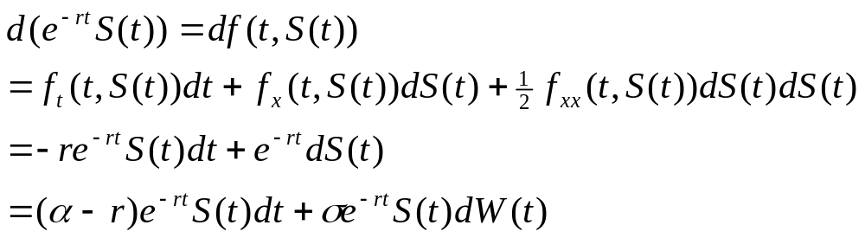
We shall often consider the discounted stock price
and the discounted portfolio value of an agent, . According to the It -Doeblin formula with ,the differential of the discounted stock price is
(4.5.4)

Slide 6
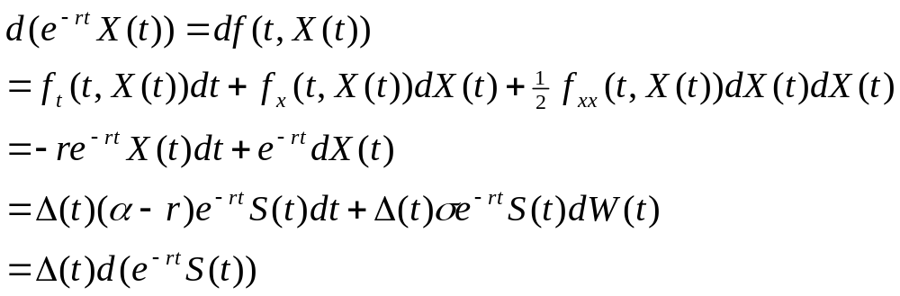
The differential of the discounted portfolio value is
(4.5.5)
Change in the discounted portfolio value is solely due to change in the discounted stock price.
代入(4.5.2)

Slide 7

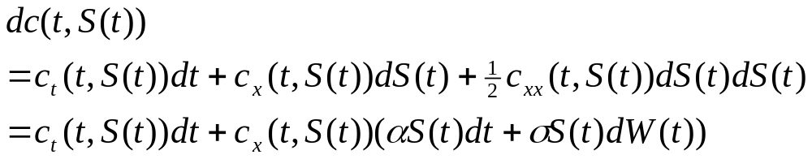


4.5.2 Evolution of Option Value
Consider a European call option that pays
at time T.
We let c(t,x) denote the value of the call at time t if the stock price at that time is S(t)=x.
(4.5.6)

Slide 8

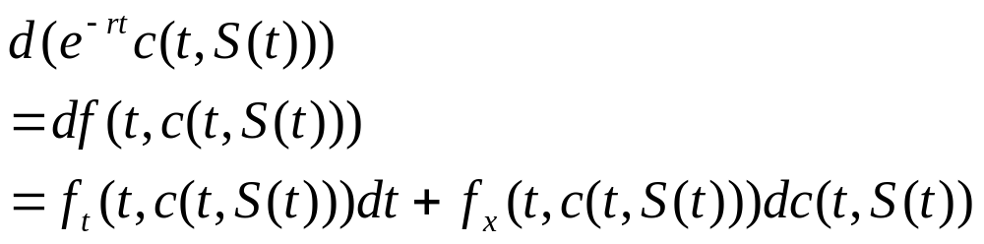
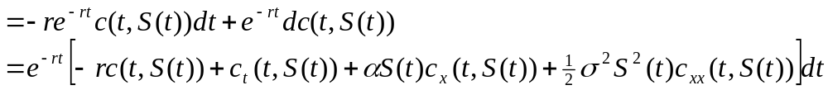
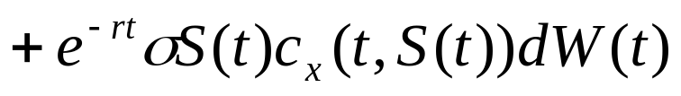
We next compute the differential of the discounted option price . Let
(4.5.7)

Slide 9


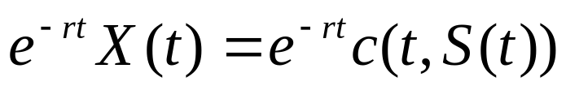

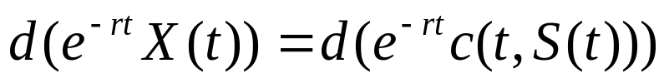


4.5.3 Equating the Evolutions
A (short option) hedging portfolio starts with some initial capital X(0) and invests in the stock and money market account so that the portfolio value X(t) at each time t [0,T] agrees with c(t,S(t)).
One way to ensure this equality is to make sure that
(4.5.8)
and .

Slide 10


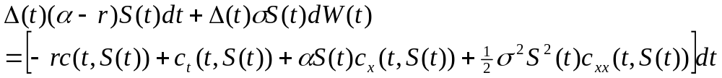

Integration of (4.5.8) from 0 to t then yields
(4.5.9)
Comparing (4.5.5) and (4.5.7),
We see that (4.5.8) holds iff
(4.5.10)

Slide 11



We first equate the dW(t) terms in (4.5.10), which gives
(4.5.11)
this is called the delta-hedging rule.
We next equate the dt terms in (4.5.10), obtain
=
(4.5.12)
(4.5.13)

Slide 12


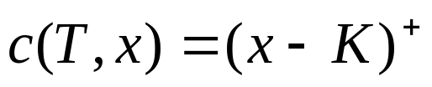
In conclusion, we should seek a continuous function c(t,x) that is a solution to the Black-Scholes-Merton partial differential equation
, (4.5.14)
and that satisfies the terminal condition
(4.5.15)

Slide 13




So we see that .
Taking the limit as t T and using the fact that both X(t) and c(t,S(t)) are continuous, we conclude that
This means that the short position has been successfully hedged.

Slide 14

4.5.4 solution to the Black-Scholes-Merton Equation
We do not need (4.5.14) to hold at t=T, although we need the function c(t,x) to be continuous at t=T. If the hedge works at all times strictly prior to T, it also works at time T because of continuity.
Equation (4.5.14) is a partial differential equation of the type called backward parabolic. For such an equation, in addition to the terminal condition (4.5.15), one needs boundary conditions at x=0 and x= in order to determine the solution.

Slide 15
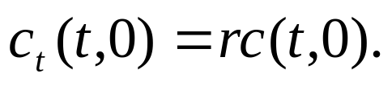



The boundary condition at x=0 is obtained by substituting x=0 into (4.5.14), which then becomes
(4.5.16)
and the solution is
Substituting t=T into this equation and using the fact that ,we see that c(0,0)=0 and hence c(t,0)=0 (4.5.17)
this is the boundary condition at x=0.

Slide 16



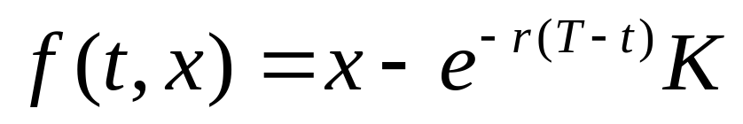
As x ,the function c(t,x) grows without bound. One way to specify a boundary condition at x= for the European call is
(4.5.18)
For large x, this call is deep in the money and very likely to end in the money. In this case, the price of the call is almost as much as the price of the forward contract discussed in Subsection 4.5.6 below (see (4.5.26)).

Slide 17

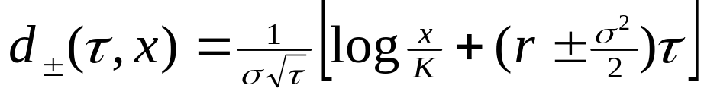
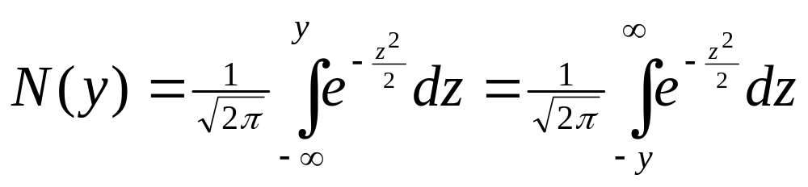
The solution to the Black-Scholes-Merton equation (4.5.14) with terminal condition (4.5.15) and boundary conditions (4.5.17) and (4.5.18) is
(4.5.19)
Where
(4.5.20)
and N is the cumulative standard normal distribution
(4.5.21)

Slide 18



We shall sometimes use the notation
(4.5.22)
and call the Black-Scholes-Merton function.
Formula (4.5.19) does not define c(t,x) when t=T,nor dose it define c(t,x) when x=0.
However, (4.5.19) defines c(t,x) in such a way that
and

Slide 19
補充 : Dummy Variable
A variable that appears in a calculation only as a placeholder and which disappears completely in the final result.

Slide 20
4.5 Black-Scholes-Merton Equation part (2)
報告者：何俊儒

Slide 21






4.5.5 The Greeks
The derivatives of function c( t, x ) of (4.5.19) with respect to various variables are called the Greeks
  Delta
  Theta
  Gamma
  Vega
  Rho
  Psi

Slide 22
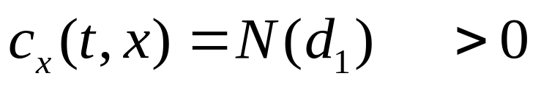
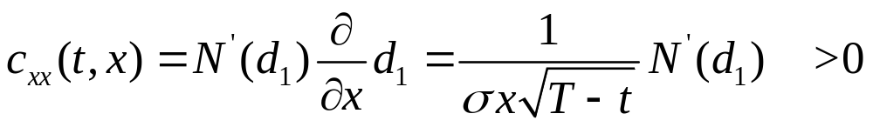
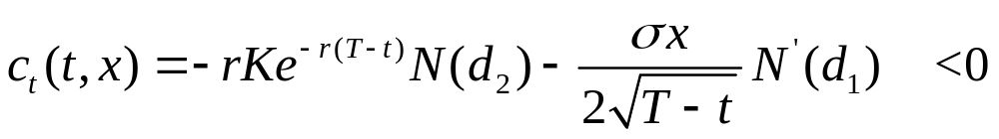
The Greeks
Delta
Gamma
Theta

Slide 23
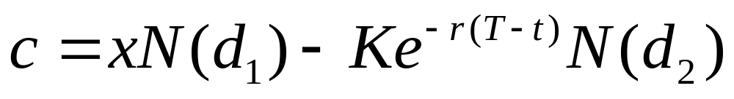
Hedging portfolio
At time t, stock price is x,
Short a call option
The hedging portfolio value is
The amount invested in the money market is

Slide 24

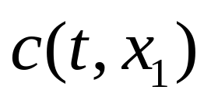
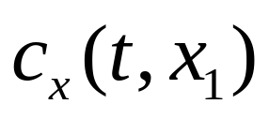

Delta-neutral position
Because delta and gamma are positive, for fixed t , the function c( t,x ) is increasing and convex in the variable x (see Fig 4.5.1)
Consider a portfolio when stock price is we
  Long a call
  Short stock
  Invest in money market account

Slide 25
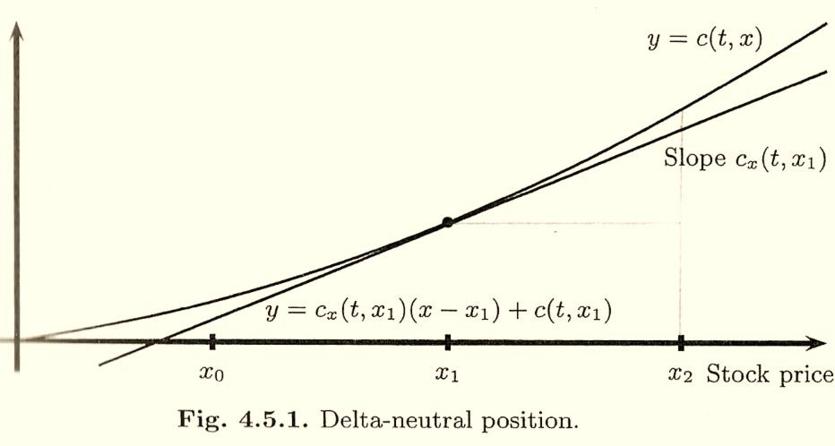
Option
value

Slide 26
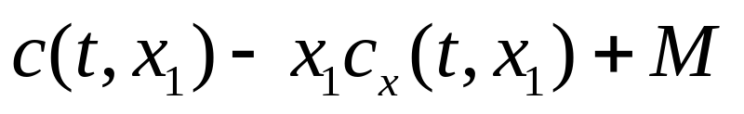

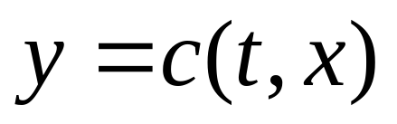
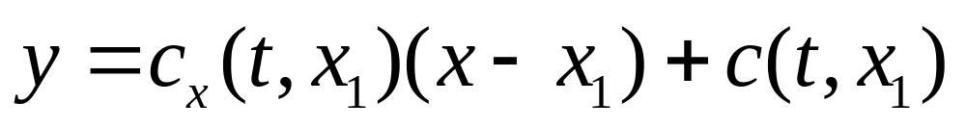
Sensitivity to stock price changes of the portfolio
The initial portfolio value is zero at time t
If the stock price were instantaneously fall to our portfolio value would change to be
This is the difference at between the curve and the straight line

Slide 27

Sensitivity to stock price changes of the portfolio
Because this difference is positive, our portfolio benefits from an instantaneous drop in the stock price
On the other hand, if the stock price were instantaneously rise to
It would result the same phenomenon
Hence, the portfolio we have set up is said to be delta-neutral and long gamma

Slide 28
Long gamma
It benefits from the convexity of c( t,x ) as described above
If there is an instantaneously rise or an instantaneously fall in the stock price, the value of the portfolio increases
A long gamma portfolio is profitable in times of high stock volatility

Slide 29
Delta-neutral
It refers to the fact that the line in Fig 4.5.1 is tangent to the curve
When the stock price makes a small move, the change of portfolio value due to the corresponding change in option price is nearly offset by the change in the value of our short position in the stock
The straight line is a good approximation to the option price for small stock price moves

Slide 30

Arbitrage opportunity
The portfolio described above may at first appear to offer an arbitrage opportunity
When we let time move forward
  both the long gamma position and the positive investment in the money market account offer an opportunity for profit
  the curve is shifts downward because theta is negative
To keep the portfolio delta-neutral, we have to continuously rebalance our portfolio

Slide 31
Vega
The derivative of the option price w.r.t. the volatility is called vega
The more volatile stocks offer more opportunity from the portfolio that hedges a long call position with a short stock position, and hence the call is more expensive so long as the put option

Slide 32
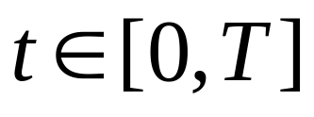
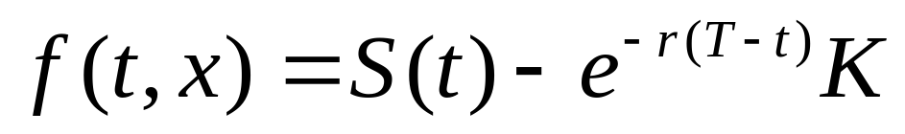
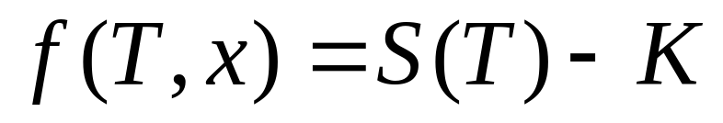
4.5.6 Put-Call parity
A forward contract with delivery price K obligates its holder to buy one share of the stock at the expiration time T in exchange for payment K
Let f( t,x ) denote the value of the forward contract at time t,
The value of the forward contract at expiration time T

Slide 33
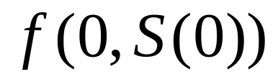
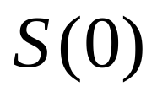
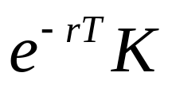
Forward contract
Static hedge
  A hedge that doesn’t trade except at the initial time
Consider a portfolio at time 0
  Short a forward contract
  Long a stock
  Borrow from the money market account

Slide 34
Replicating the payoff of the forward contract
At expiration time T of the forward contract
  Owns a stock S(T)
  Debt to the money market account grown to K
Portfolio value at time T
  S(T)-K
Just replicating the payoff of the forward contract with a portfolio we made at time 0

Slide 35
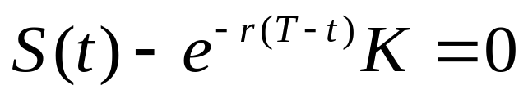
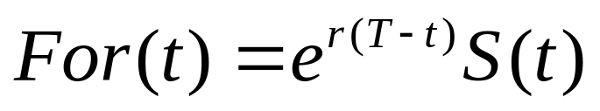
Forward price
The forward price of a stock at time t is defined to be the value of K that cause the forward contract at time t to have value zero
i.e., it is the value of K that satisfies the equation
The forward price at time t is
The forward price isn’t the price of the forward contract

Slide 36
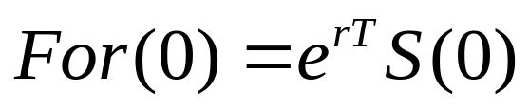
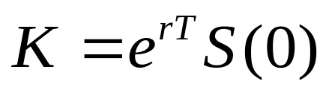
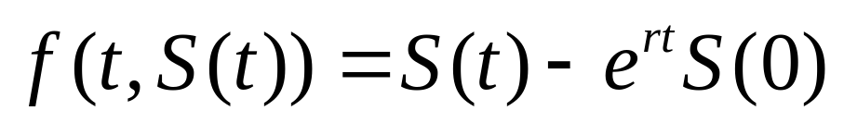
Forward price
The forward price at time t is the price one can lock in at time t for the purchase of one share of stock at time T, paying the price at time T
Consider a situation at time 0, one can lock in a price for buying a stock at time T
Set
The value of the forward contract at time t

Slide 37
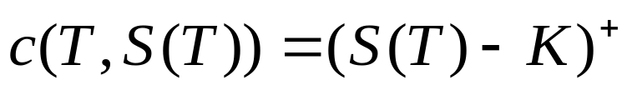
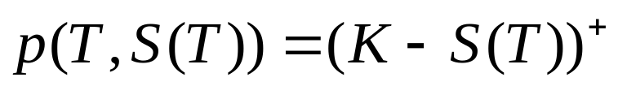
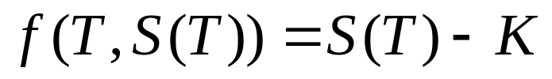
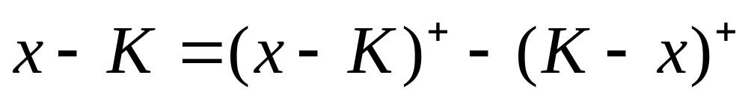
Put-Call Parity
Consider some of the derivatives and their payoff at expiration time T
  European call
  European put
  Forward contract
Observe a equation that will hold for any number x
(4.5.28)

Slide 38
Put-Call Parity
Let x = S(T), the equation (4.5.28) implies
The payoff of the forward contract agrees with the payoff of a portfolio that is long a call and short a put
The value at time T is holding , so long as holding at all previous times
(4.5.29)

Slide 39
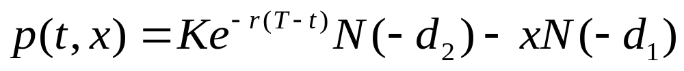
Put-Call Parity
The relationship of equation (4.5.29) is called put-call parity
We can use the put-call parity and the call option formula we derived from the Black-Scholes-Merton formula to obtain the Black-Scholes-Merton put formula

Slide 40
Thanks for your listening!!

